Slide 1
Reconstruction of chromosome’s local structure using HiC experimental data
Technical report Ofir Shukron

Slide 2
Background + motivation
Reconstruction of an “average” local structure (connectivity) of chromatin from HiC encounter data;
HiC/5C/4C/3C gives frequency of looping events in cell population;
No temporal information in the encounter frequency;
Non equilibrium properties are not seen;
Cells display great variability in chromatin structure;

Slide 3
Agenda
The data
Smoothing method for the HiC data
Transform probabilities to distances
Results of reconstruction
Comparison to experimental data
Perspectives
Data processing
reconstruction
comparison

Slide 4
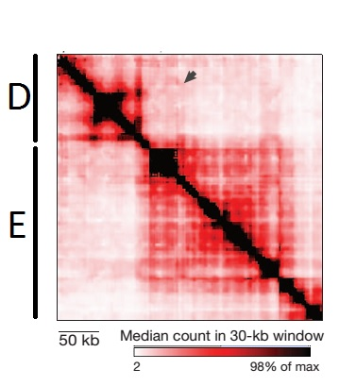
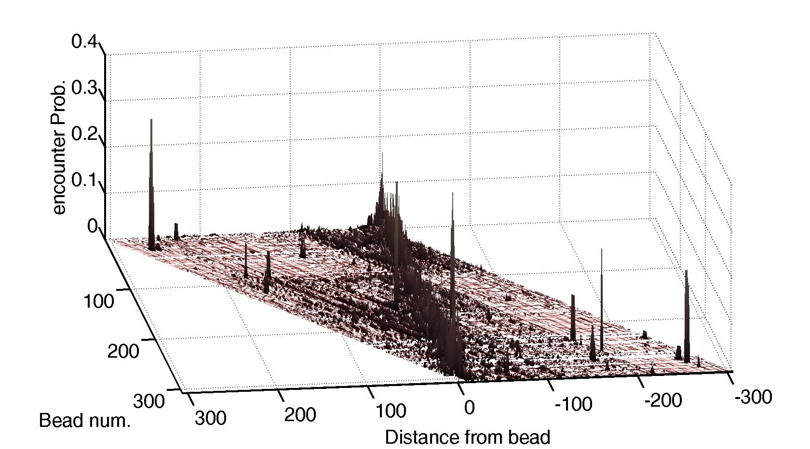
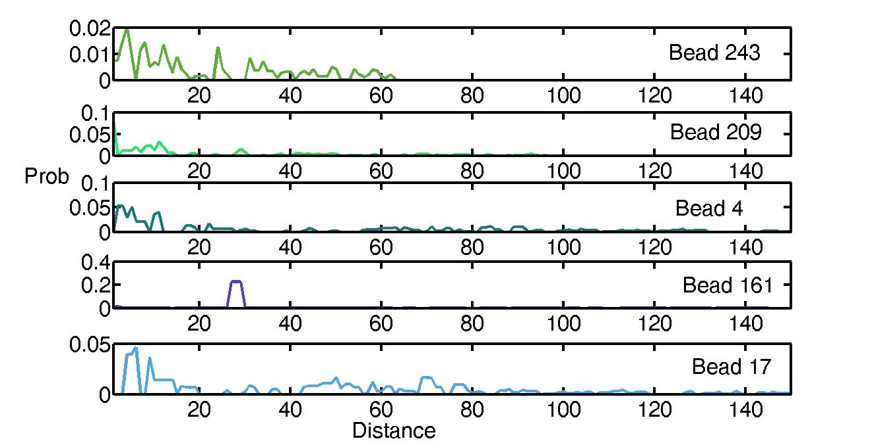
The Data
1
Encounter Freq.
3
Encounter Prob. Centered view
4
Right encounters
2
left
right
1
N

Slide 5
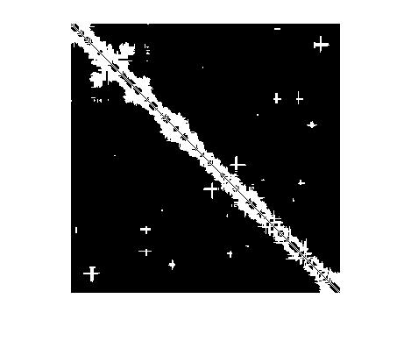
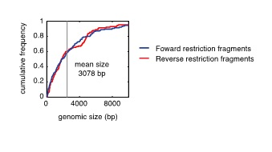
Reconstruction output
Encounter frequency
Connectivity (structure) map
Bead num.
Bead Num.
Connected Not connected

Slide 6
Scope and assumptions
The HiC represent the equilibrium encounter distribution;
HiC data is “noisy” (discretization, missing counts);
The underlying polymer model is Rouse;
Reconstructed polymer will represents an “average” structure.

Slide 7
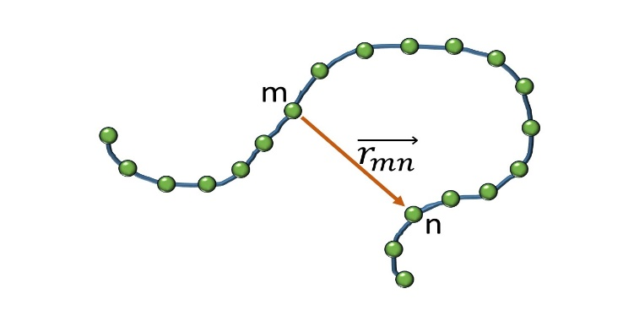
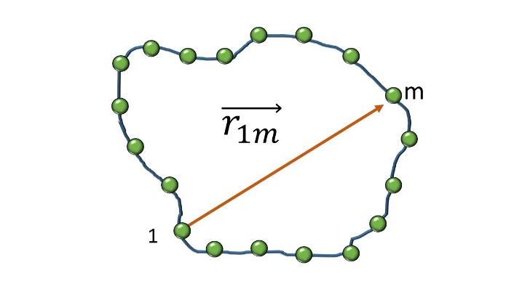
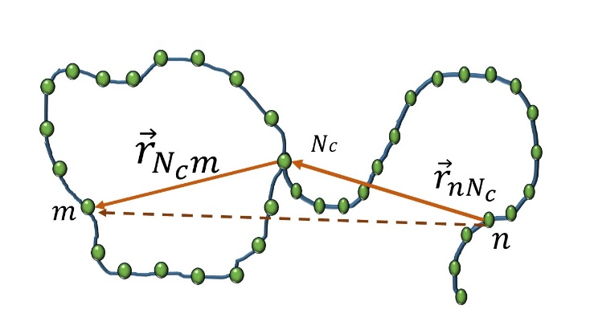

Encounter probabilities under the Rouse assumption
For linear Rouse chain with $N$ beads. The vector between beads m and n is Normal with: ${ f_{C}\left(x;m,n\right)=\left(\frac{3}{2πb^{2}\left|m−n\right|}\right)}^{1.5}exp⁡\left(\frac{−3x^{2}}{2{\left|m−n\right|}^{2}}\right)$ Setting $x=0$ we get the encounter probability
The Rouse ring with $N_{r}$ beads is a Brownian bridge with$N_{r}$steps, the vector between beads at distance $m$from each other is given by: ${f_{R}\left(x;m\right)=\left(\frac{3}{2πb^{2}m (N_{r}−m)}\right)}^{1.5}\exp\left(\frac{−3x^{2}}{2(m{\left(N_{r}−m\right))}^{2}}\right)$ setting $x=0$ gives the encounter probability
In a composite structure, the vector is given by the addition of two Normally distributed vectors
$$f_{com}\left(x;n,m\right)=f_{C}\left(x;n,N_{c}\right)∗f_{R}\left(x;m\right)$$
which is Normally distributed
More complex structures follow similar logic as above

Slide 8
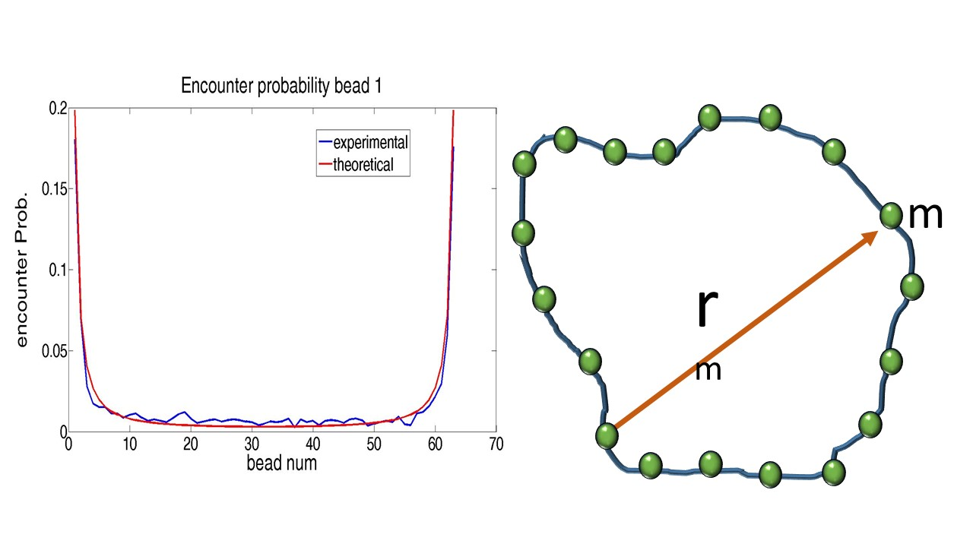
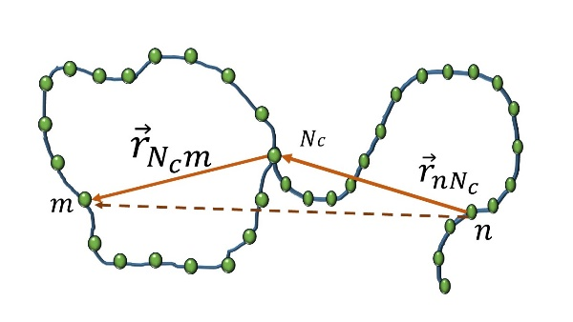
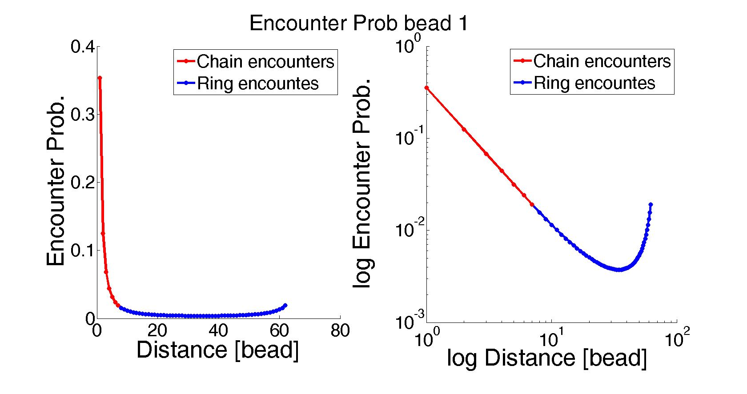
Encounter probabilities

Slide 9
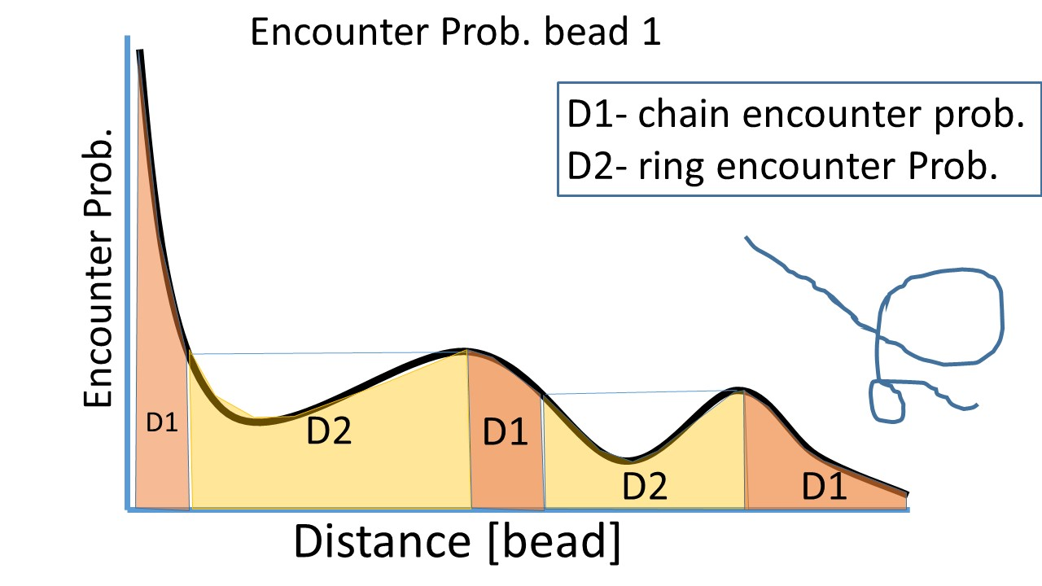
From encounter probabilities to structure- theory
Under the Rouse polymer assumption, equal encounter probabilities indicates equal distances along the chain
1

Slide 10
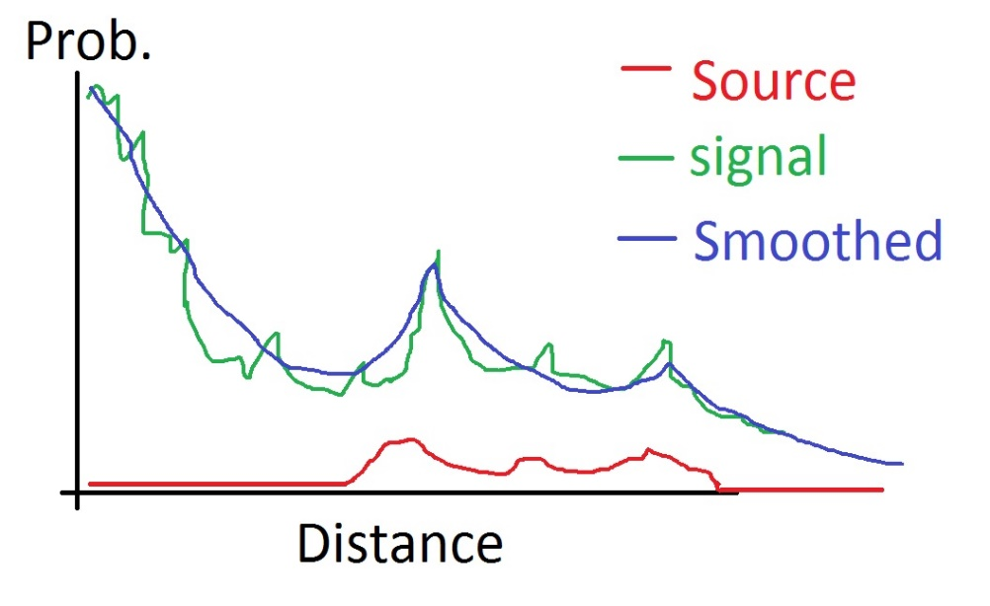
Noisy encounter signal
Experimental signal are not “well behaved”.
Missing observations for some beads
Under Rouse assumption, the distribution of vectors between beads is the fundamental solution to the diffusion (heat) equation;
The composition of fundamental solution is unknown;
A theoretical heat source function will help us find it.

Slide 11






Smoothing by solving the inverse heat source problem
Theory
Practice
1. Find a function $r(t)$and temperature $u(x,t)$ which satisfy the eq.
$$u_{t}=u_{xx}+r\left(t\right)f(x,t)$$
Subject to:
$$u\left(0,t\right)=u\left(1,t\right), u_{x}\left(0,t\right)+αu\left(0,t\right)=0$$
$$u\left(x,0\right)=φ\left(x\right), \int_{0}^{1}{u\left(x,t\right)dx=E(t)}$$
[Hazanee et. al. 2013]
For each HiC signal $u^{∗}(t)$ we set: $f\left(x,t\right)=1, 0≤x≤1, 0≤t≤T$
$$u\left(0,t\right)=u\left(1,t\right)=u^{∗}(t), u_{x}\left(0,t\right)+αu\left(0,t\right)=0$$
$$α=−1$$
Initial conditions:
$φ\left(x\right)=u\left(x,0\right)=u^{∗}(0)$
Heat energy:
$$\int_{0}^{1}{u\left(x,t\right)dx}=E(t)$$
Using the Boundary Element method (BEM) Hazanee et. al. devised a scheme for the inverse heat source
$$u\left(x,0\right)=u^{∗}(0)$$
Observed Temp.
$$u(1,t)$$
1
We search the solution at the initial point $x=0$ for which we get encounter probability.
ill posed problems requires the use of Tikhonov regularization term
space
Temp
0
$$u(0,t)$$
T
Time

Slide 12
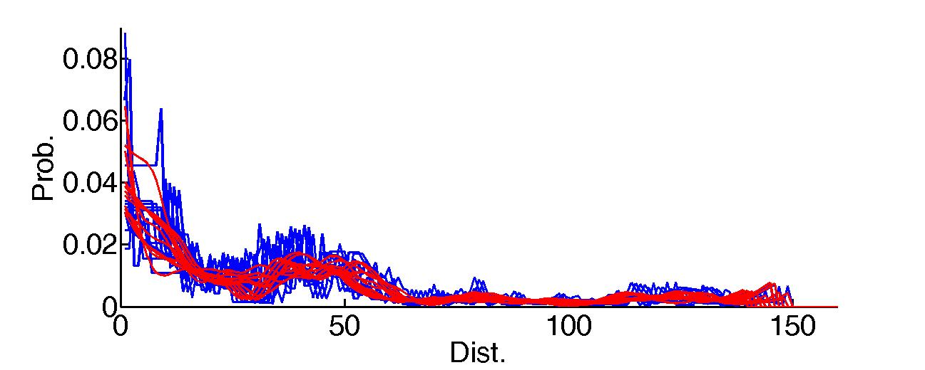
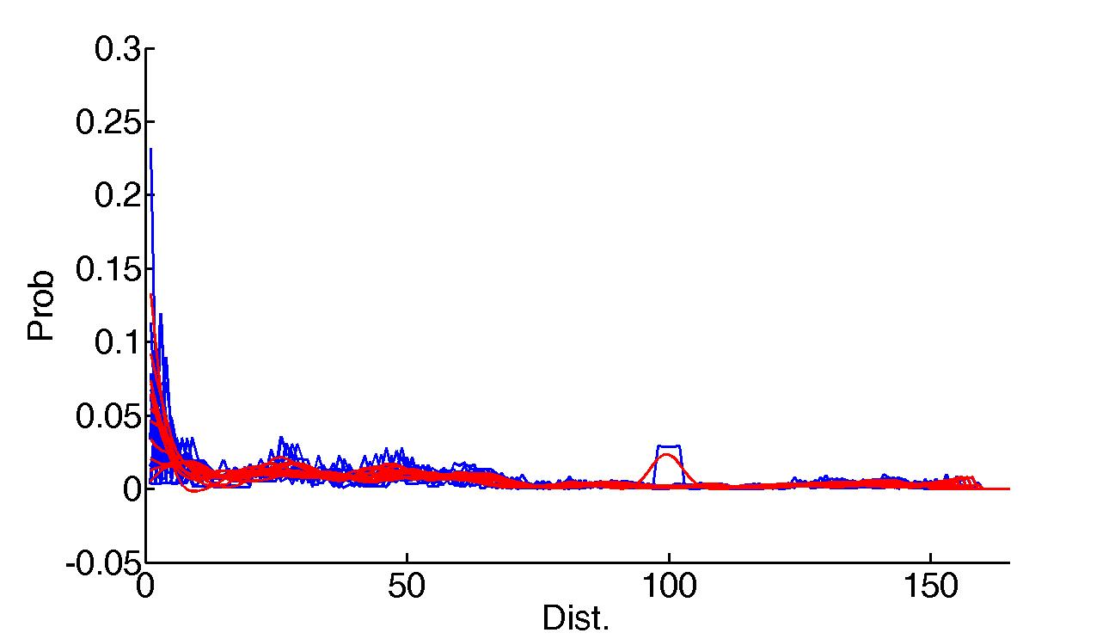
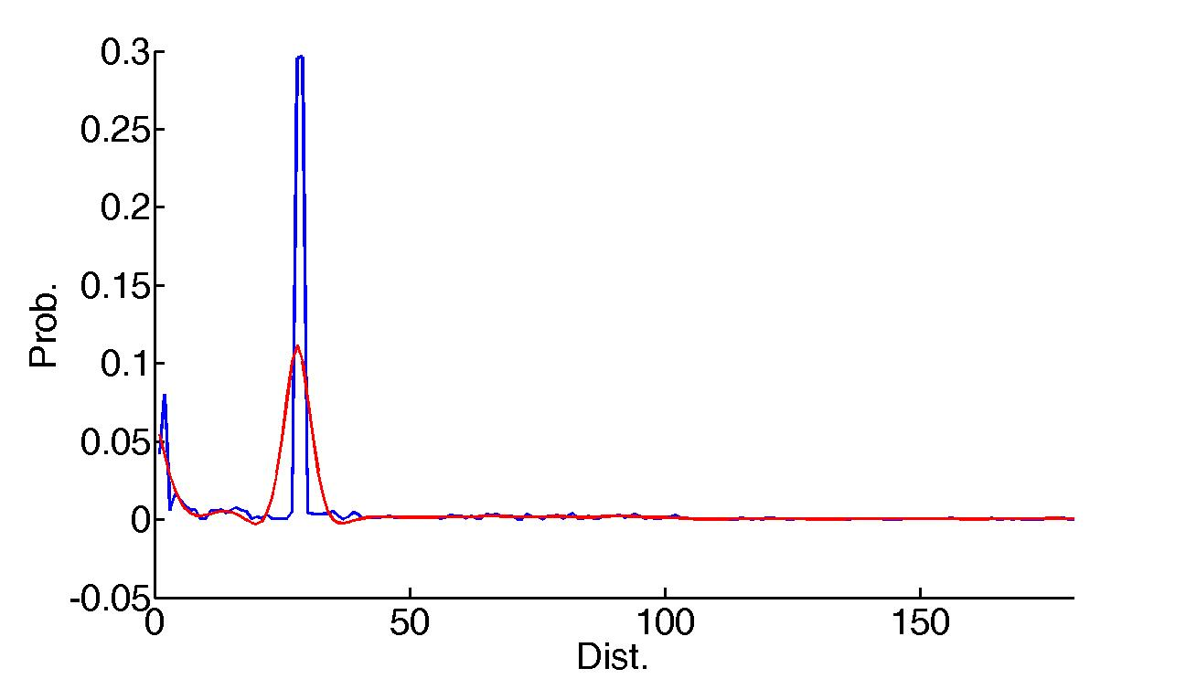
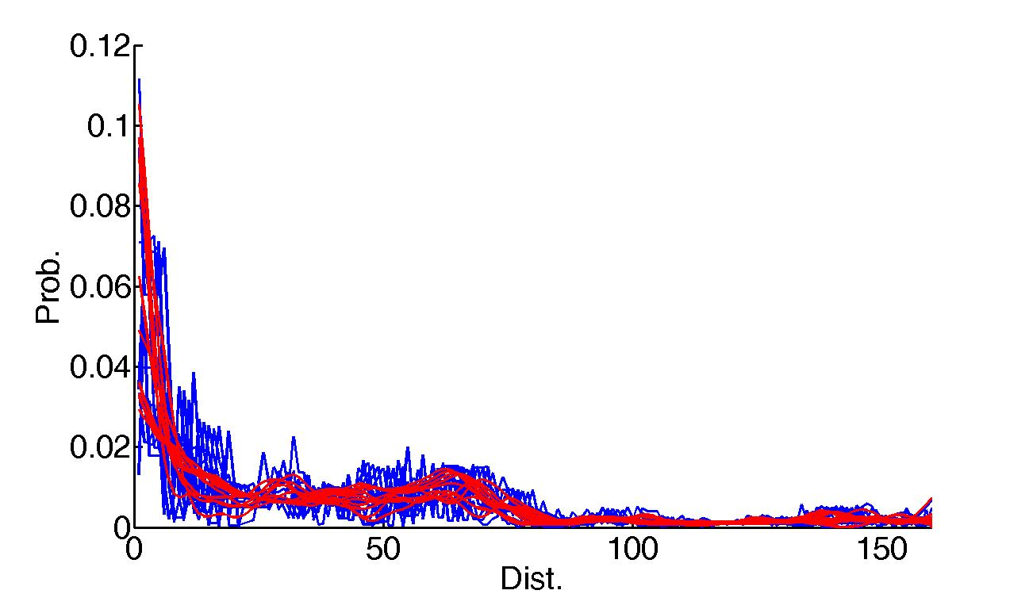
Some smoothing results
140-150
160-170
191
150-160

Slide 13
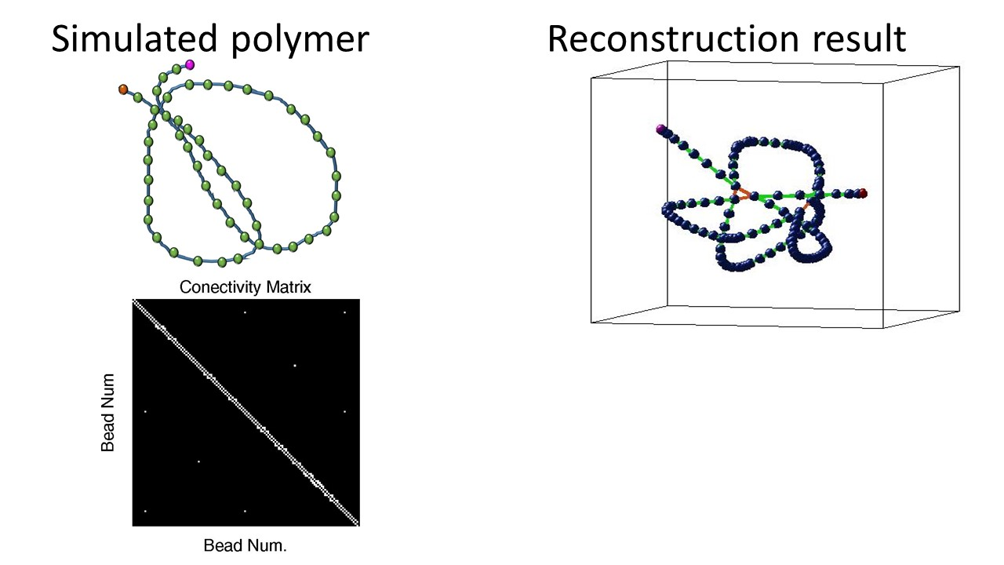
Reconstruction
After projection, round to the nearest integer to get connectivity
Before applying it on the HiC data, test with synthetic example
Test on synthetic example

Slide 14
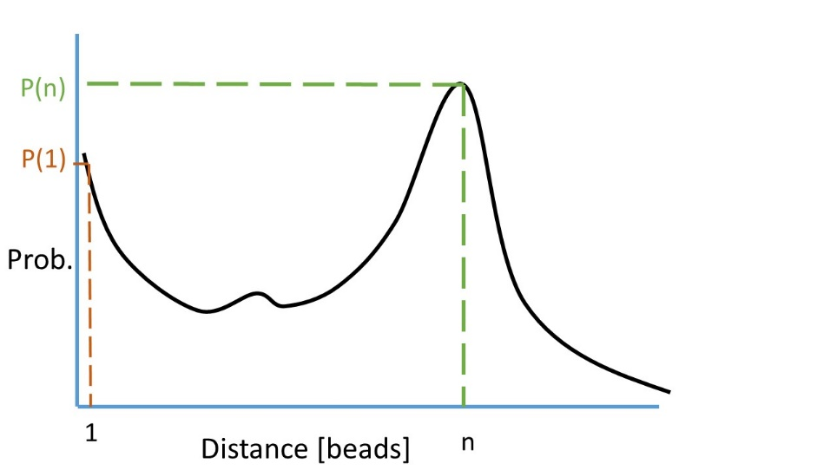
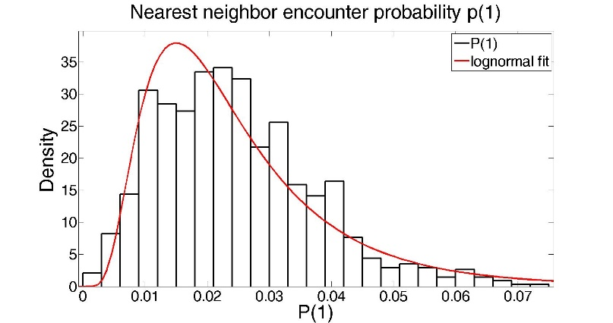
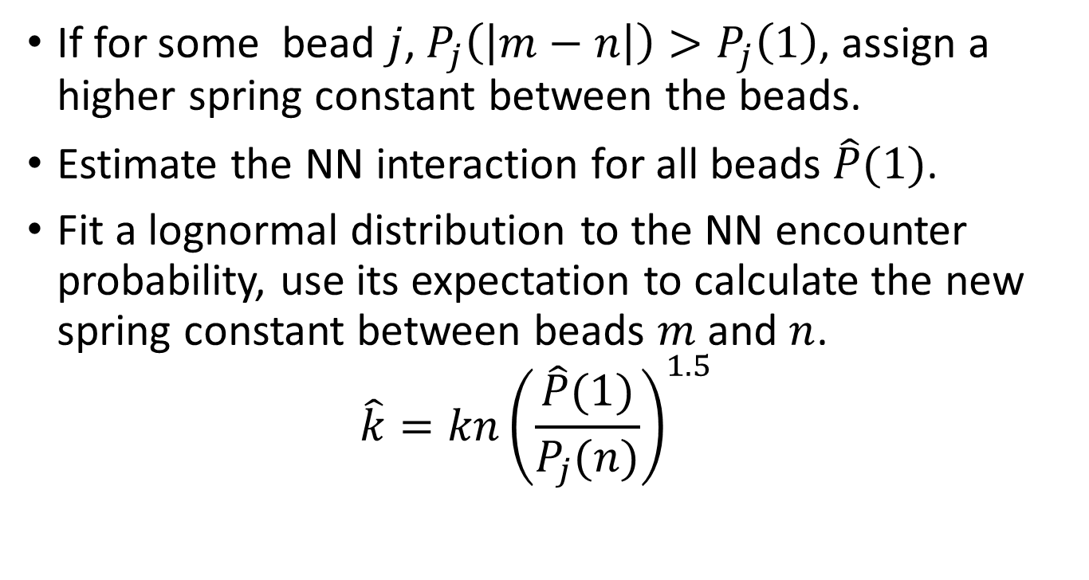
Adjusting the spring constant
Bead j
If for some bead $j$, $P_{j}\left(\left|m−n\right|\right)>P_{j}\left(1\right)$, assign a higher spring constant between the beads.
Estimate the NN interaction for all beads $\hat{P}(1)$.
Fit a lognormal distribution to the NN encounter probability, use its expectation to calculate the new spring constant between beads $m$ and $n$. $\hat{k}=kn{\left(\frac{\hat{P}(1)}{P_{j}(n)}\right)}^{1.5}$

Slide 15
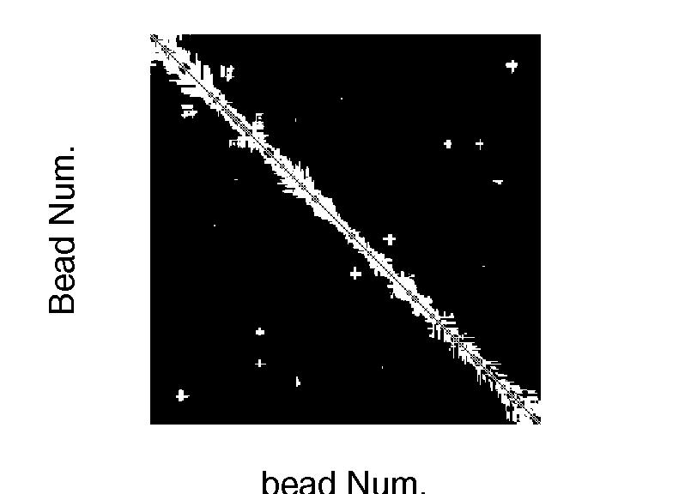
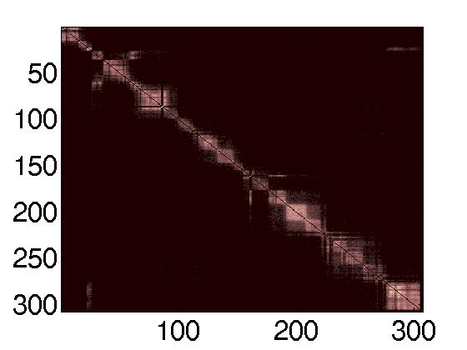
HiC data
Connectivity Matrix
* Result of 2000 simulations
Connected Not connected

Slide 16
To be done
Reconstruction
Statistical test for agreement with loop location
Comparison measure between experimental and reconstructed (simulated)
Regularization term in smoothing, to be chosen automatically
Comparison of smoothing methods
Simulations
The mean first encounter time for different parts of the chain
Analytical
Find method to diagonalize general connectivity matrix

Slide 17
To be asked
Is it possible to find a single polymer structure which represents the data? Maybe a distribution is needed?

